Slide 1
Intro to Forensics
FSU Cybersecurity Club
September 2016
Joe Partlow – CTO/CISO, ReliaQuest

Slide 2
Whoami
Joe Partlow – CTO/CISO, ReliaQuest
Been in the IT and information Security industry for over 20 years and have experience in Operations Management, Information Security, Network Security, Systems Design, Risk Assessment, Database Administration, Network Infrastructure, Web Application Development, Systems Design & Integration and Project Management.
Just a guy interested in forensics!

Slide 3
Agenda
Common areas of forensics
Acquisition of evidence
Best Practices
Live Acquisition
Memory
Anti-Forensics
Further Research

Slide 4
Types Of Forensics
Traditional disk-based
Use imaging software such as DD, EnCase, etc. to pull a copy of the target disk (Platter, SSD, USB, Mounted).
Check for artifacts stored on the disk – registry keys, files, alternate data streams, etc. using tools such as Foremost, Autopsy, Deft, Sift, etc.
Memory forensics
Using software such as Volatility to analyze artifacts stored completely in memory or a VM image.

Slide 5
Types Of Forensics – Cont.
Network Forensics
Using tools such as Wireshark, TCPdump or Network Miner to check for artifacts being sent on the wire or parse files being sent.
Mobile forensics
Combination of all types above using tools such as Android SDK (adb), apktool, etc.
Anti-Forensics
Hiding your tracks by trashing the logs or changes timestamps etc.

Slide 6
Rules of Engagement
Minimize the amount to times you touch disk or memory – Don’t trash the evidence!
Don’t install any programs on the victim machine – Machine needs to be in he exact or closest possible state when compromised.
Ensure repeatable results or at least methods – Be prepared to defend any action taken or scripts ran on the machine to opposing parties or defendants.
Document all actions or scripts and timeline everything – Need to show due diligence and best practices.

Slide 7
Rules of Engagement – Cont.
Hash any files you copy from the victim machine to ensure they were not modified.
Should output to a remote file share or USB to avoid overwriting local disk and trashing unallocated/swap space.
Use trusted binaries in case of suspected rootkit and looks better from a legal standpoint.
Go into every engagement thinking it will have to stand up in court!!!

Slide 8
How It Goes Wrong
Real-life acquisition fail story…
Learn the tools you will be using
Practice using your tools ahead of time
Watch your surroundings

Slide 9
Acquiring Evidence
Disk or Drive based – Done by doing a bit for bit copy of a hard drive and analyzing for anything stored on the disk.
Memory – Doing a dump of all active memory and looking for artifacts still contained or running in memory
Running System State – Capturing a snapshot of what services or processes are running along with current network connections or logged on users
Virtual Machine – same as options as above or grab a paused machine and get everything at once!

Slide 10
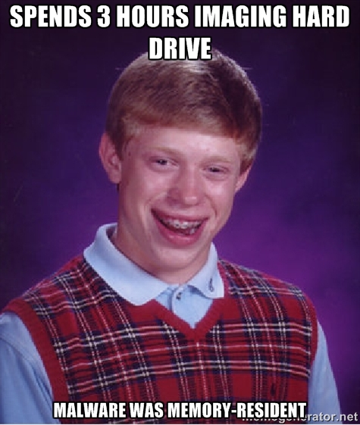
Why Live Acquisition?
Live acquisition is the process of pulling forensic artifacts from a running machine
But wait!!! Doesn’t that violate the rule about pulling the plug immediately?
DD or similar being the sole method of forensics been dead for years but surprised how often I still run into this mindset (from customers and from fellow forensic people)

Slide 11
Why Is It Important?
Many valuable artifacts may disappear when shutting the machine down including:
Active network connections (machine may be actively participating in a botnet)
Memory resident malware
Currently logged on users
Currently running services
Traditional disk image forensics may not work:
VM-aware malware or attack
Location-aware malware or attack
May not have the time to image or unable to take the equipment with you (smash and grab or blackbag jobs)

Slide 12
What Should We Get?
Memory dump – Try to acquire this first so you don’t trample over them memory with the rest of your searches
Disk dump – Also try to acquire this first so you don’t create more artifacts
System Config – Network settings, Shares, Drive info, Local user accounts, installed applications and patches
Network Connections – Who is the machine currently talking to
Startup Information – Programs or scripts set to run when machine is started up. Usually buried in registry keys
Running Processes and Services
Scheduled tasks

Slide 13
What Should We Get? – Cont.
Cookies and Browser cache
List of USB devices used
Event Logs – Events cleared, time changes, logon failures, Privileged Use, application crashes
Advanced
Drivers loaded
Last 50 DLLs created
Downloaded executable files
DNS cache (failed and successful)
Shellbags – Set of registry values for GUI useful for building timelines of events to prove suspect was traversing/viewing folders
Registry keys for shell commands, Browser helper objects, etc.
Interesting files (Prefetch, compressed, encrypted, ADS, no extension, etc.)
Live packet capture

Slide 14
Analysis Time!
Once we pull all the static and dynamic information from the machine that we need, the actual work begins!
Files created/modified in the last X days or particular date
Files owned/modified by a particular user in last X days or particular date
Look for known IOCs (Indicators of Compromise)
Typically IP/DNS addresses, File Hashes, malware files, URLs, etc.
These may be easier to search in memory dump, but some items can be found in disk also

Slide 15
Analysis Time! – Cont.
Search through memory using Volatility for files, processes, passwords, registry keys etc. Check out the Volatility Plugins page…
Search through registry hives for shellbags (Reg keys containing size, view, icon, and position of a Explorer folders) with sbag (TZWorks)
Check active network connections against known blacklist IPs (OSINT lists)
Check sqlite databases (iTunes backup) for phone activity
Run strings against the ADS files, selected binaries or files with no extensions, etc.

Slide 16
Why Memory?
Memory forensics is the practice of extracting and analyzing artifacts left in the system’s memory during or after use
Many new pieces of malware are memory resident only to avoid traditional disk based discovery.
Most if not all malware now has memory–resident components

Slide 17
The Process
Dumping the memory
Lots of scripts and stuff…
Profit!!!

Slide 18
Dumping Memory
Don’t restart the machine or the classic “pull the plug”.
Hardware – Does not write into memory and potentially trash artifacts, but needs to be installed ahead of time. Can be separate PCI cards installed ahead of time or the “freezing method”.
Software – Easiest method, but requires the software program to be loaded into memory and may alter existing artifacts. Sometimes requires agents to be loaded.
Crash Dumps – Most accurate but may truncate memory in the dump.

Slide 19
Dumping Memory - Cont.
Tools:
Volatility
FTK
MoonSols MemDump
Windump
EnCase
Mandiant Memoryze
LiME (Linux Memory Extractor) - for Linux and Android

Slide 20
Dumping Memory - Cont.
There are many interesting areas to grab the memory from including:
Page/Swap files
Hibernation Files
VM snapshots
Old crash dumps

Slide 21
Analyzing Memory
Parsing the memory
Extract any images
Find associated data and processes/network connections
Timeline and document infection
Recommend doing this on linux versus windows since grep, strings and other utilities come in handy! (or use cygwin)
So what can we see…

Slide 22
Analyzing Memory – Detailed
Identify Rogue Processes
Analyze Process DLLs and Handles
Review Network Artifacts
Look for Evidence of Code Injection
Check for Signs of a Rootkit
Dump Suspicious Processes and Drivers

Slide 23
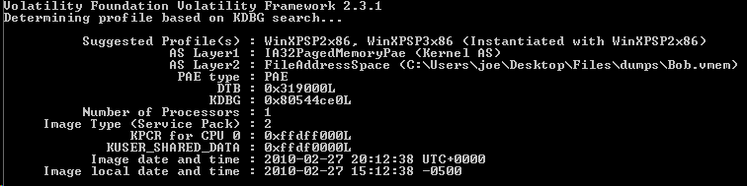
System Information
What type of machine was the memory taken from
volatility-2.5.standalone.exe –f victim.vmem imageinfo

Slide 24
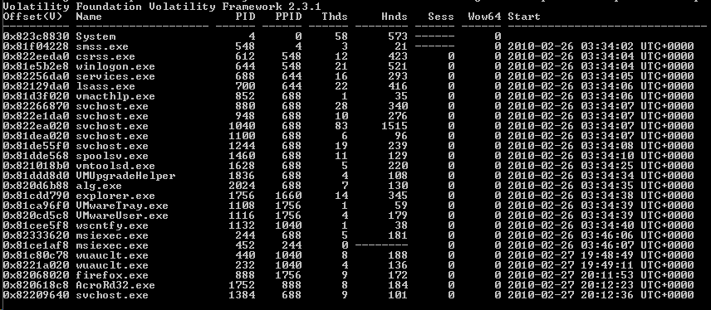
Process List
Processes running on victim’s machine
volatility-2.5.standalone.exe –f victim.vmem pslist

Slide 25
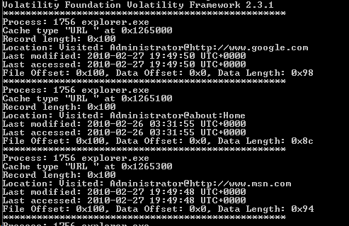
IE History
Get list of browser history from IE
volatility-2.5.standalone.exe –f victim.vmem iehistory

Slide 26
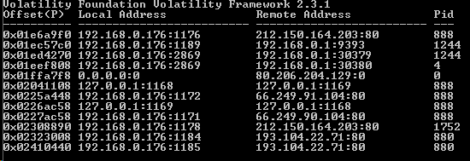
Network Connections
List of network connections
volatility-2.5.standalone.exe –f victim.vmem connscan

Slide 27
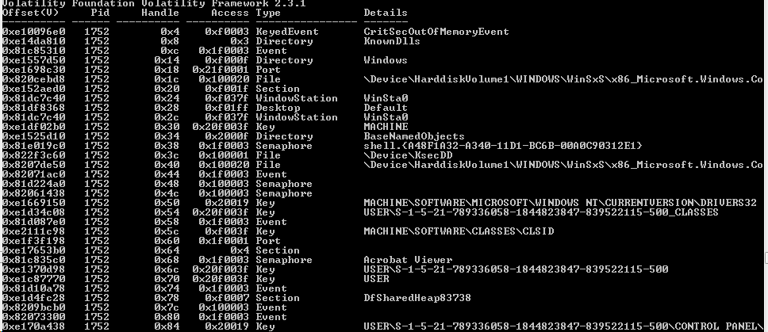
Handle Checks
Display any handles being used by the process ID
volatility-2.5.standalone.exe –f victim.vmem handles –p 1752

Slide 28
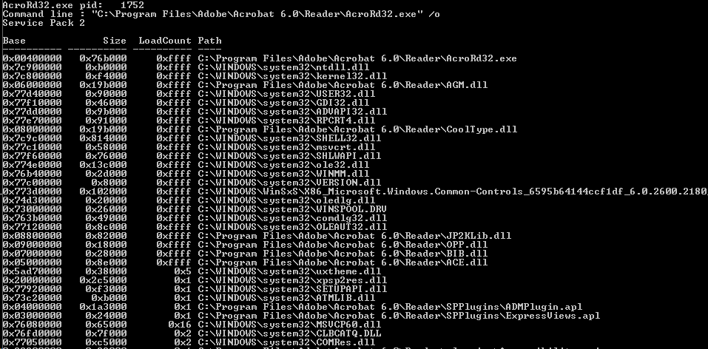
DLL Checks
Display any dlls being used by the process ID
volatility-2.5.standalone.exe –f victim.vmem dlllist

Slide 29
Clipboard Contents
Find artifacts that may still be in the clipboard memory
volatility-2.5.standalone.exe –f victim.vmem clipboard

Slide 30
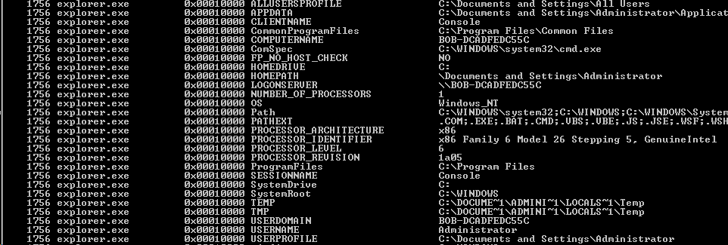
Environmental Variables
Many items that may be helpful in attribution including hostname, logonserver, path, sessionname, username, etc.
volatility-2.5.standalone.exe –f victim.vmem envars

Slide 31
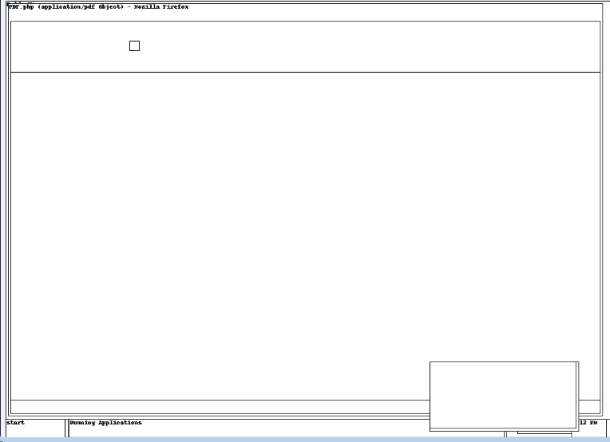
Screen Layout
Attempts to grab a visual wireframe representation of the user’s active desktop
volatility-2.5.standalone.exe –f victim.vmem screenshot –-dump-dir=“c:\temp”

Slide 32
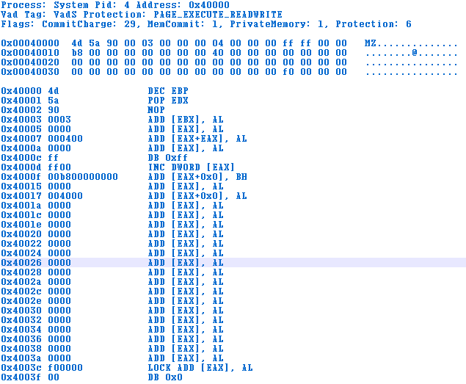
Malware Finder
Extract any executables from processes and check for known signatures
volatility-2.5.standalone.exe –f victim.vmem malfind –output-file=malware1

Slide 33
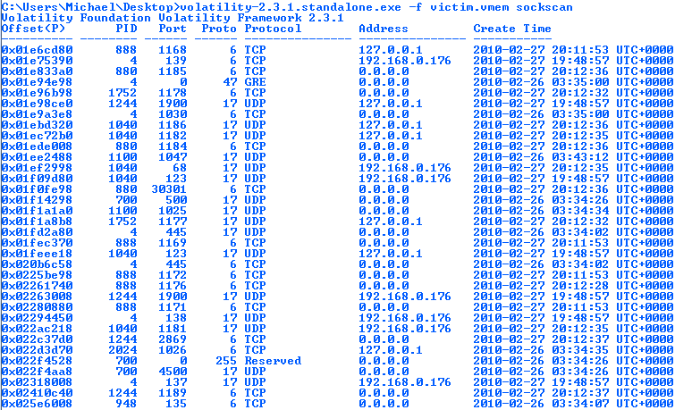
Socket Scan For Abobe PID

Slide 34
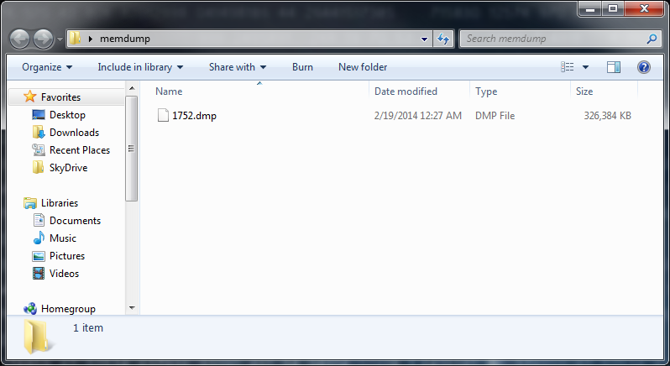
Dump out Adobe Reader File

Slide 35
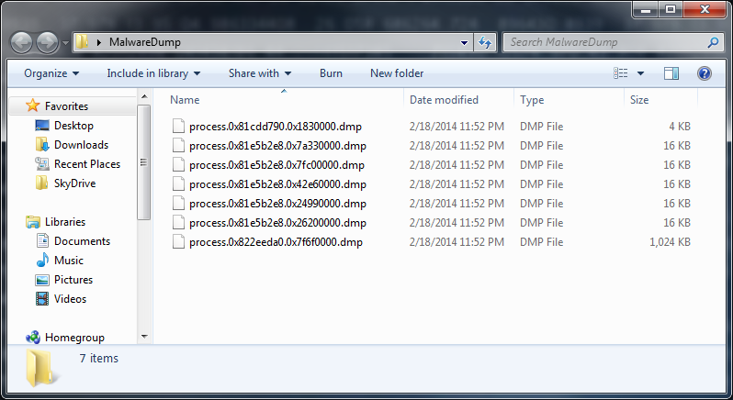
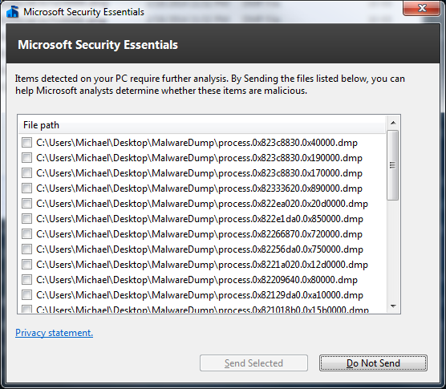
Don’t Dump it on your computer…

Slide 36
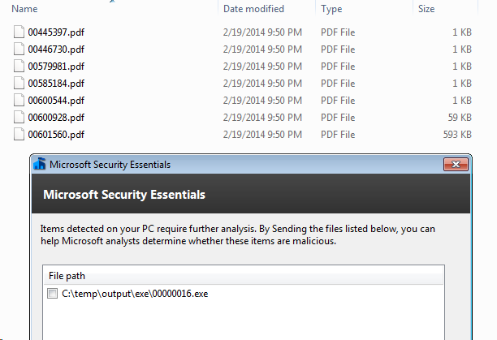
Parse Actual Files
Once we have the dump for that process, we can start parsing for actual files
foremost -i 1752.dmp –o “C:\temp\output”

Slide 37
Other Fun Options
These commands could also yield some good data:
Cmdscan – list of all commands used based off history
Dumpcerts – Finds all RSA public and private SSL keys
Hashdump – Dumps any SAM hashes to be used to potential cracking
Windows – Shows all window handles and associated processes running at the time of the memory capture
Registry options including hivelist, hivescan, printkey which will show you active keys being used by the running processes

Slide 38
Anti-Forensics
Like other areas of forensics (network, disk, etc.), there is an interest to hide activities with various methods
Stop the acquisition process from happening – Ex. overwrite removable storage if serial doesn’t match
Pollute or hide the results – ex. Timestomp
Cause “reasonable doubt”

Slide 39
Anti-Forensics – Cont.
Lots of cool area of research and like everything in security, it’s a cat and mouse game
ADD (Attention Deficit Disorder) – Presented at Shmoocon couple years ago, at a high level scatters artifacts around, alters signatures and adds fake evidence (network connections, well known rootkit drivers, fake processes). EVIL!
This also leaves behind traces and can be picked up sometimes by being thorough in looking in all areas for malicious traffic.

Slide 40
Further Research
Network Forensic CTF – http://forensicscontest.com
SANS DFIR portal - http://digital-forensics.sans.org/community/downloads
Free download of SIFT VM forensics workstation
Also has challenges to solve
Deft Forensic Distro - http://www.deftlinux.net
Int0x80 (of Dualcore) – Few anti-forensics videos from DefCon, Derbycon, etc. - http://www.irongeek.com
Check out my github for examples - https://github.com/partlowjoe

Slide 41
Questions?
Thank You!
Joe Partlow (jpartlow@reliaquest.com)

